Slide 1
Performing Global Updates in Alma Using Sets and Jobs
Yoel Kortick May 2024

Slide 2
Agenda
Introduction
Change Physical Items information
Update/Notify Users
Change Electronic portfolio information

Slide 3
Introduction

Slide 4
Introduction
An integral and powerful part of Alma is the ability to perform global updates on a wide variety of data.
The process typically involves first making a set of the data and then running an “information update” job on the set.
This functionality allows the institution to maintain an efficient and up to date repository.
In this presentation we will focus on globally updating non-bibliographic data.
  Bibliographic data is updated using normalization rules and the corresponding normalization processes.
  In the situation here we will be using different jobs to update non-bibliographic data
See also Manual Jobs on Defined Sets.

Slide 5
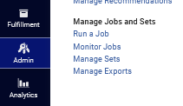
Introduction
Most of the jobs in Alma which perform Global Updates can be accessed at “Admin > manage Jobs and Sets > Run a Job”.

Slide 6
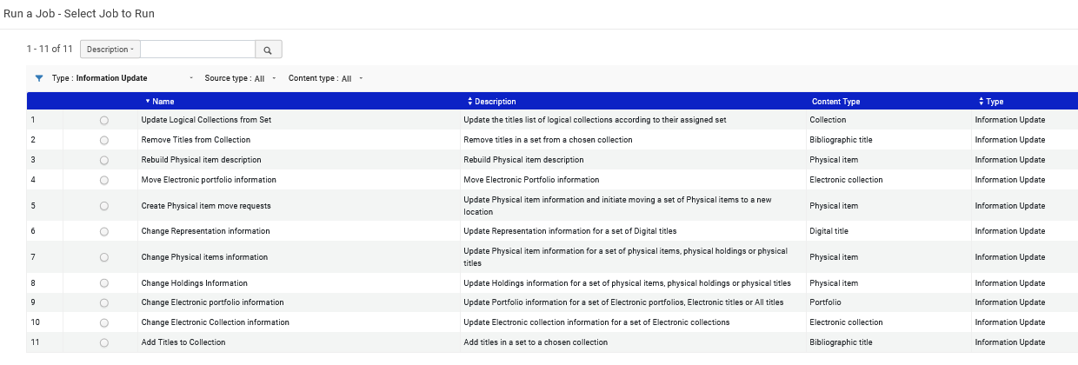
Introduction
It is possible to filter the jobs. Here we filter by “Information Update”

Slide 7
Introduction
Note that all examples in this presentation are real use-case scenarios which were needed and run by actual institutions.

Slide 8
Change Physical Items information

Slide 9
Change Physical Items information
The “Change Physical Items information” job updates item information.
  When an item changes location and a new holdings record is created, the old holdings record is deleted if there are no other items attached.
  If other items are still attached, the old holdings record and any PO line attached to it remain in place.
  If a PO line was attached to a holdings record that is deleted, the PO line is detached from any holdings.
See also Performing Global Changes on Physical Item Records

Slide 10
Change Physical Items information
The parameters in the “Change Physical Items information” correspond to the options available on the Physical Item Editor tabs.
When running the job (as we will soon see) the user should select the checkbox at the beginning of each row for which he or she wants to make a change.
For each parameter (other than the Change location fields parameters), select if the change is to occur:
  Unconditionally
  Only if the field is empty
  Only if the field is not empty
The job can run on sets of type:
  Physical Items
  Physical Titles
  Physical Holdings

Slide 11
Change Physical Items information
In our first example we will make a set of items which we want to move to a certain location.
We have already used an internal workflow to physically move the items.
Now we want to globally make the change in Alma.

Slide 12
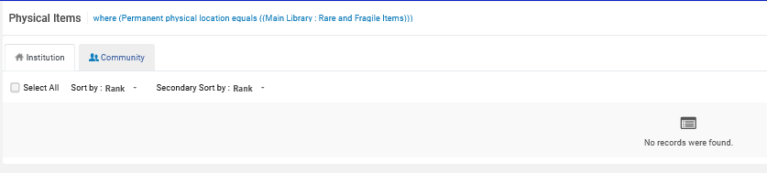
Change Physical Items information
In the case here all items in any location of the Main Library which have “Physical Condition” = “Fragile” will be moved to the Main Library “Rare and Fragile Items” location.
Currently there are no items in the Main Library “Rare and Fragile Items” location.

Slide 13
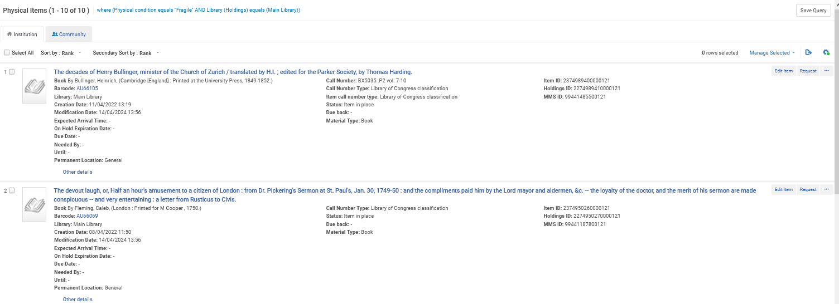
Change Physical Items information
We will create a set of all items which have physical condition “Fragile”.
First, we search for the items and create a set.
Click here to create a set
Physical items search by “Physical condition = Fragile” and Library = ‘Main Library’

Slide 14
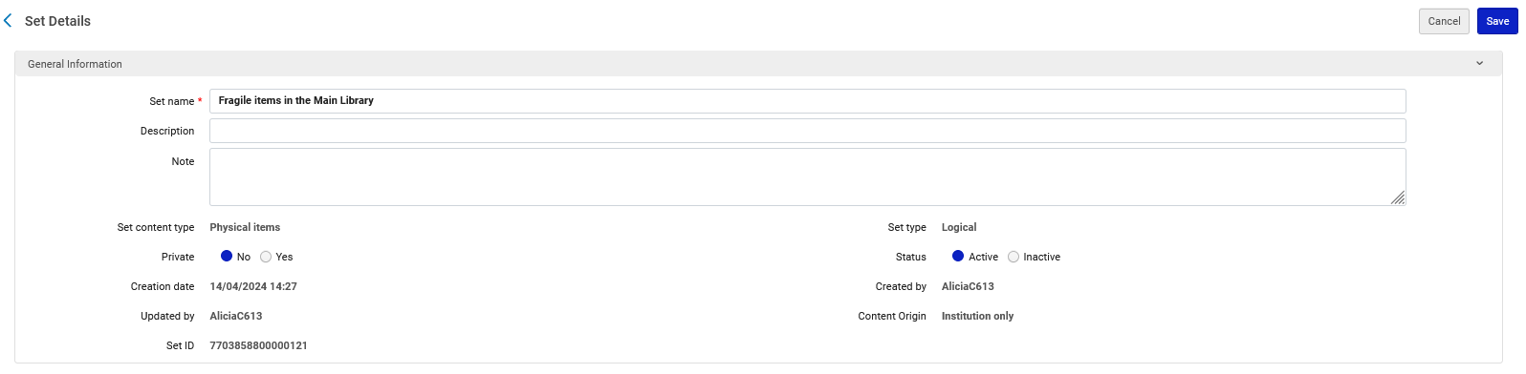
Change Physical Items information
We save the set with name “Fragile items in the Main Library”.

Slide 15
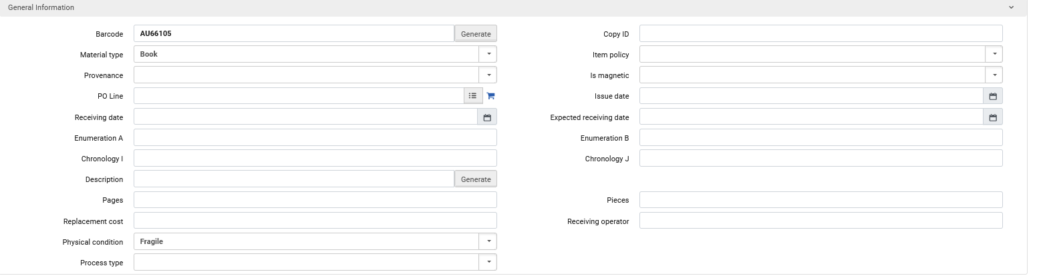
Change Physical Items information
All items in the set have Physical condition “Fragile”.

Slide 16
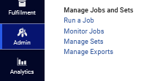
Change Physical Items information
Now we will run the job “Change Physical Items”.
First, we will access “Run a job”.

Slide 17
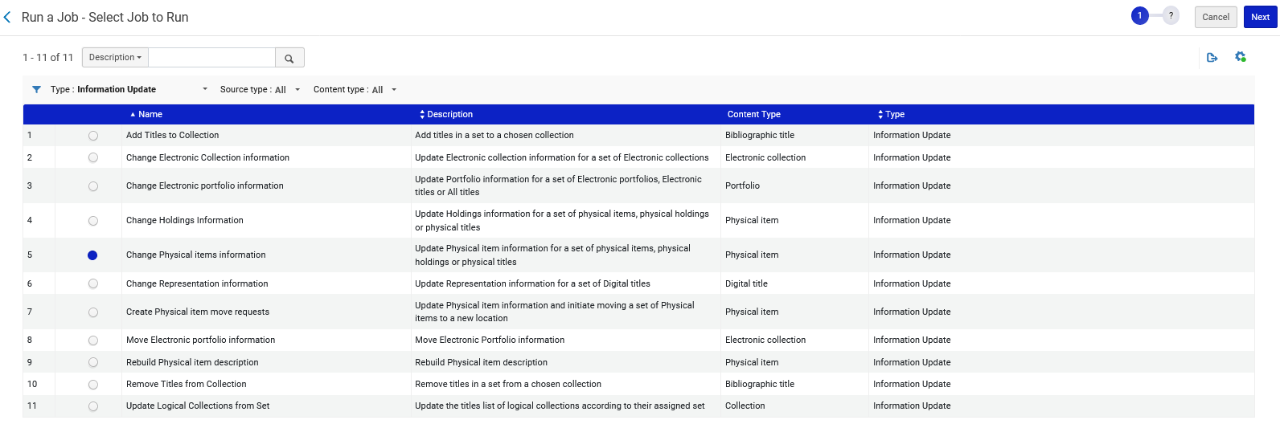
Change Physical Items information
Then we will filter by type “Information Update” and choose “Change Physical Items Information”

Slide 18
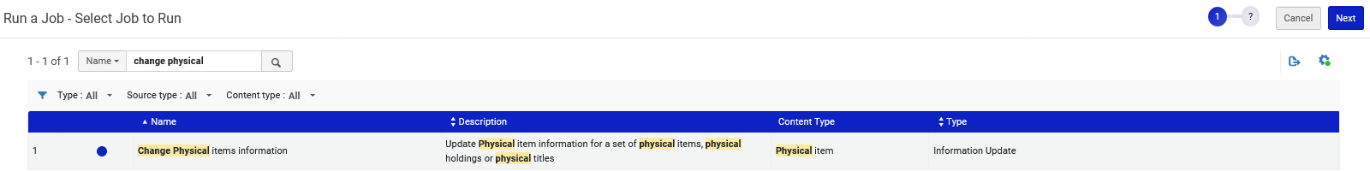
Change Physical Items information
Note that it is not required to filter the “Type” of job. We can also search by name or description.

Slide 19
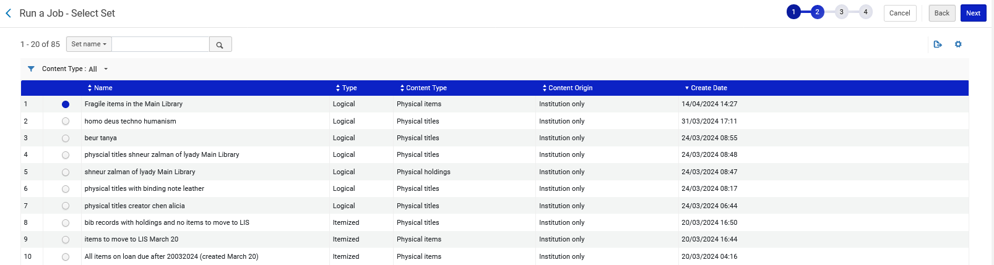
Change Physical Items information
After choosing the job and clicking “Next” we will select the desired set

Slide 20
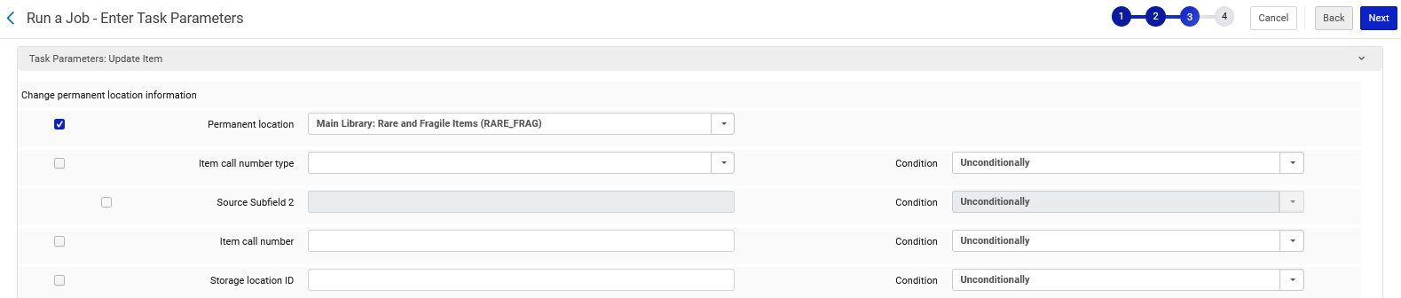
Change Physical Items information
Then in the job we select the desired new Permanent location

Slide 21
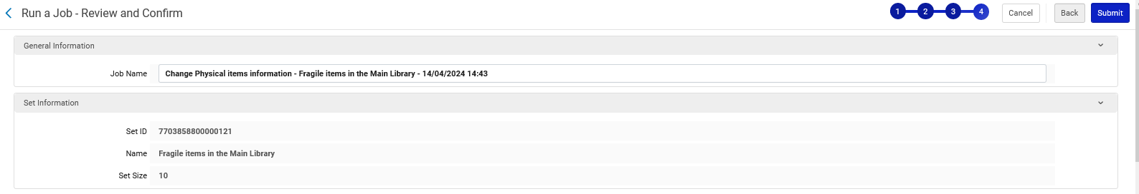
Change Physical Items information
Confirm the change and submit

Slide 22
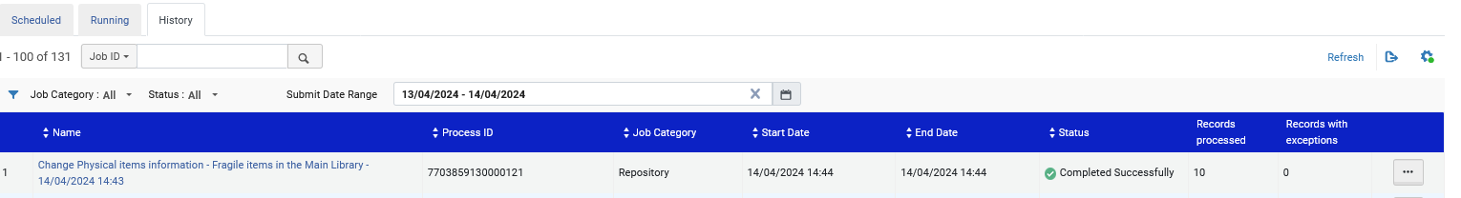
Change Physical Items information
The job successfully completes

Slide 23
Change Physical Items information
Let’s go see the items in the set

Slide 24
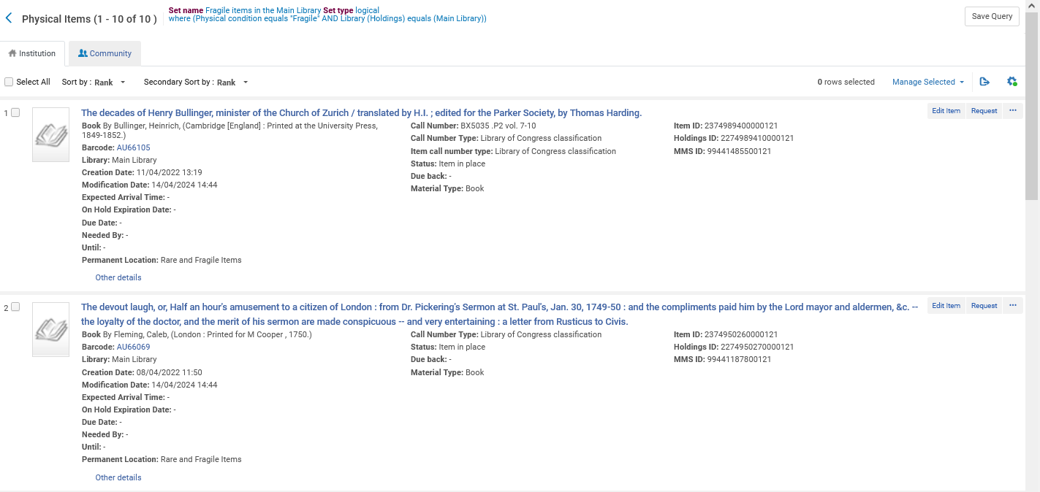
Change Physical Items information
They have all been moved to location “Rare and Fragile Items”

Slide 25
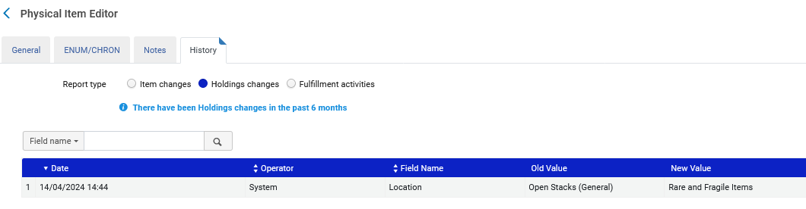
Change Physical Items information
In the History tab of the Physical Item Editor we can see the change was made by “System” (which is a job).
We see that the change was made on the location.

Slide 26
Update/Notify Users

Slide 27
Update/Notify Users
The “Update/Notify Users” job allows the staff user to either
  Globally update a set of users
  Sent a letter to a set of users
In the example here we will globally update a set of users.

Slide 28
Update/Notify Users
First, we will retrieve all users who are expired. This means that their expiration date is in the past.
Then we will give all of those users a purge date.
The purpose of giving the users a purge date is so that they can later be deleted using the job “Purge User Records” under “Admin > User Management”

Slide 29
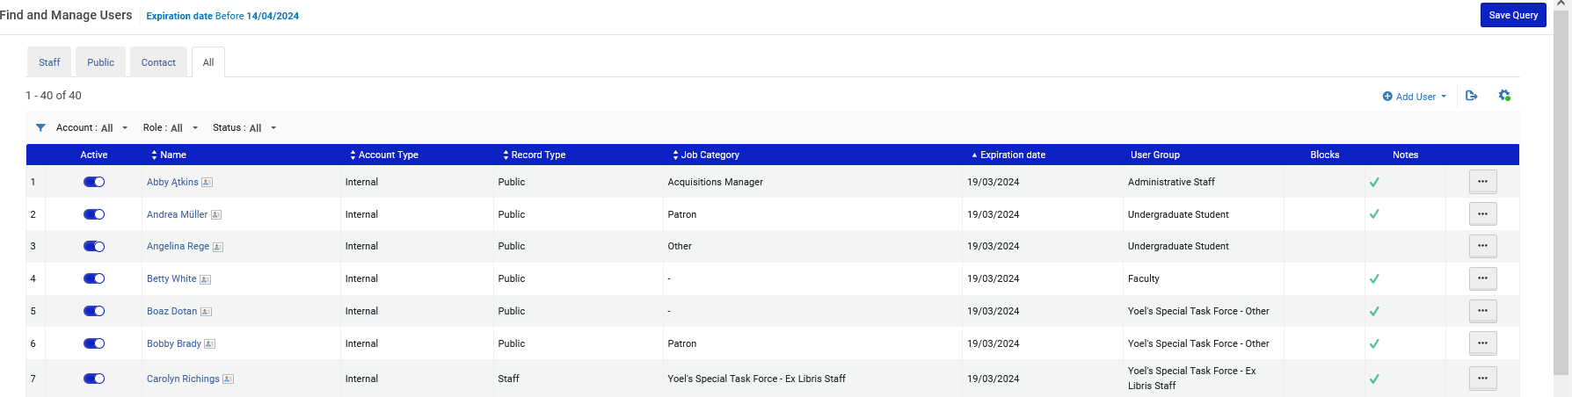
Update/Notify Users
These are all users with an expiration date before today (April 14, 2024).
We will create a set of these users.

Slide 30
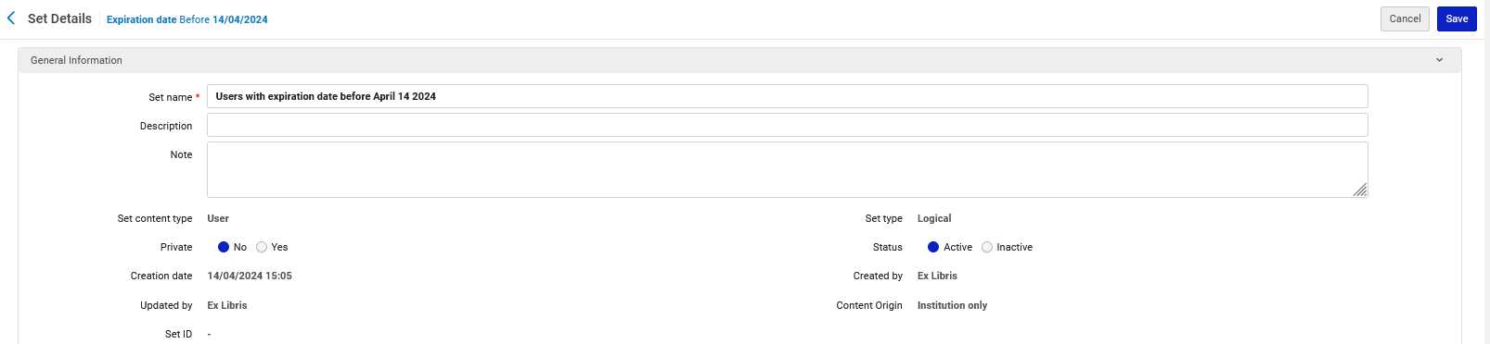
Update/Notify Users
We have called the set “Users with expiration date before April 14 2024”

Slide 31
Update/Notify Users
Now we will run the job “Update/Notify Users”.
First, we will access “Run a job”.

Slide 32
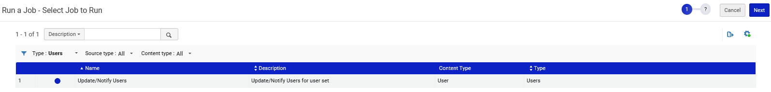
Update/Notify Users
Then we will filter by type “Users” and choose “Update/Notify Users”

Slide 33
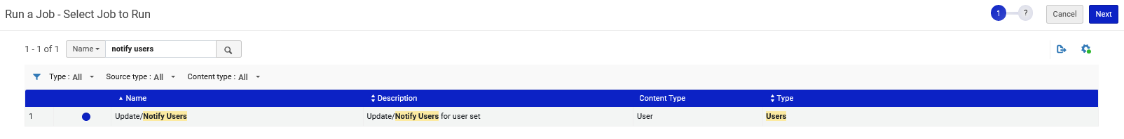
Update/Notify Users
Note that it is not required to filter the “Type” of job. We can also search by name or description.

Slide 34
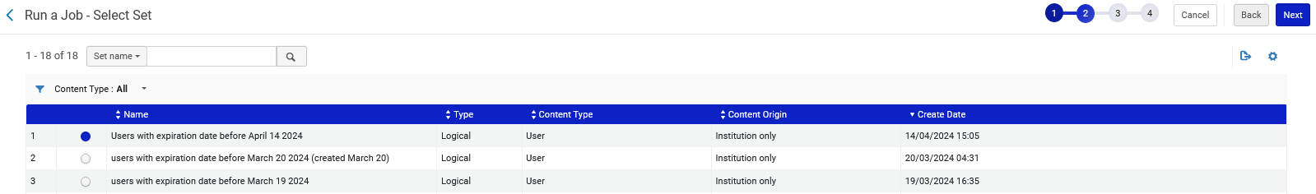
Update/Notify Users
After selecting the job and clicking “Next” we will select the desired set

Slide 35
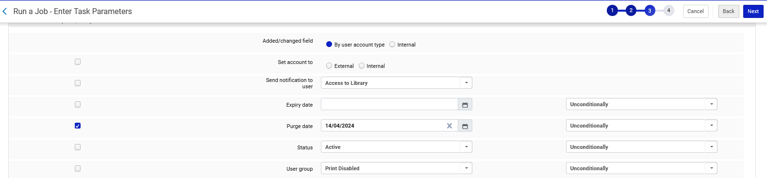
Update/Notify Users
Then in the job select the desired new Purge Date

Slide 36
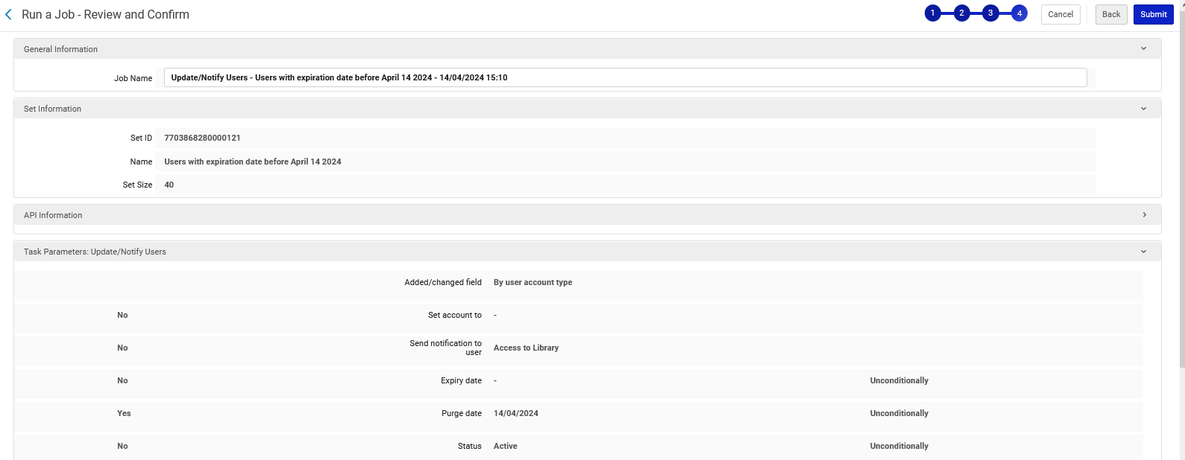
Update/Notify Users
Confirm the change and submit

Slide 37
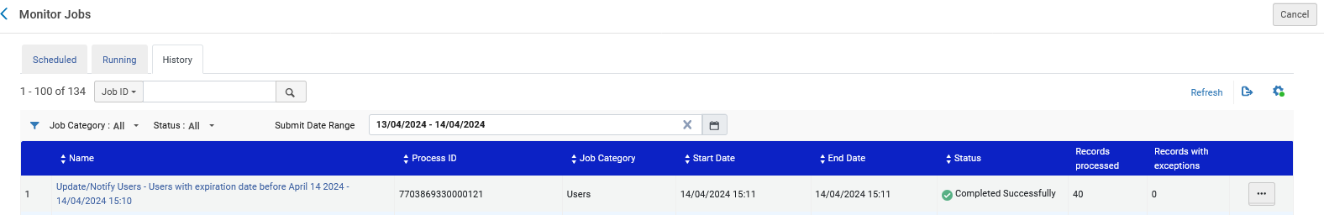
Update/Notify Users
The job successfully completes

Slide 38
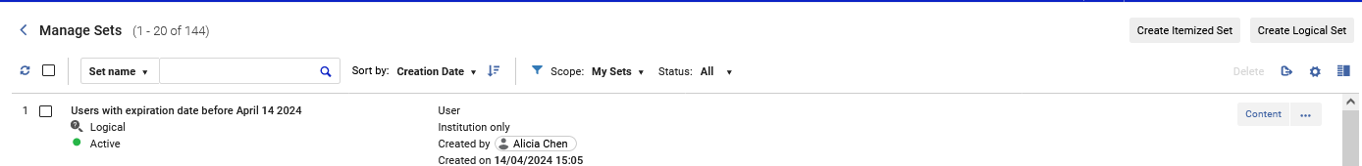
Update/Notify Users
Let’s go see the users in the set

Slide 39
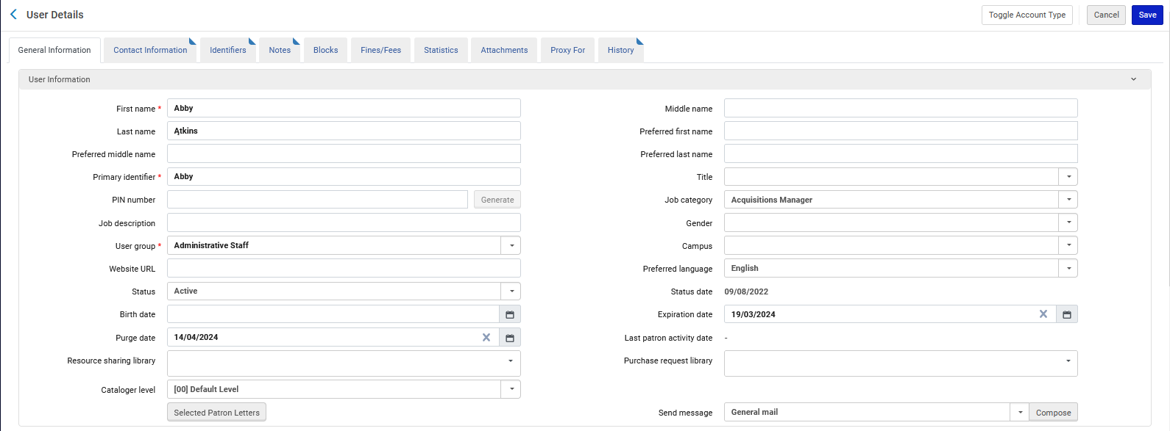
Update/Notify Users
They have all been given the new Purge Date

Slide 40
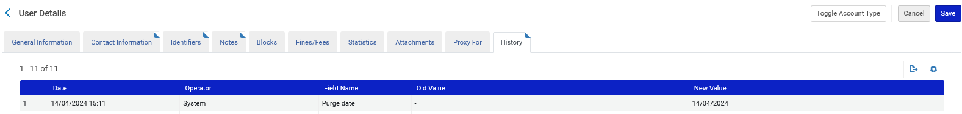
Update/Notify Users
In the History tab of the User Details we can see the change was made by “System” (which is a job)

Slide 41
Change Electronic portfolio information

Slide 42
Change Electronic portfolio information
The “Change Electronic portfolio information” job allows the staff user to make global changes on all portfolios of a set.
The fields which can be changed in this job are similar to those fields which appear in the Portfolio Editor.

Slide 43
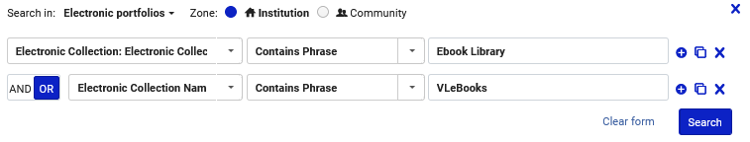
Change Electronic portfolio information
First, we will retrieve all portfolios in Electronic Collection “Ebook Library” or “VLeBooks”
Then we will give all of those portfolios an authentication note “Off campus access may require additional login”
First, we will perform an advanced search for “Electronic Portfolios” where (Electronic Collection Name contains phrase "Ebook Library") OR (Electronic Collection Name contains phrase "VLeBooks")

Slide 44
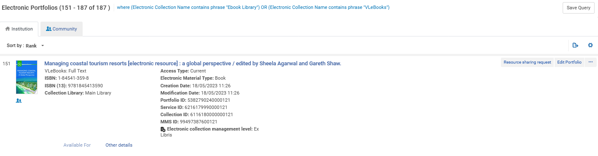
Change Electronic portfolio information
We will create a set of these portfolios.

Slide 45
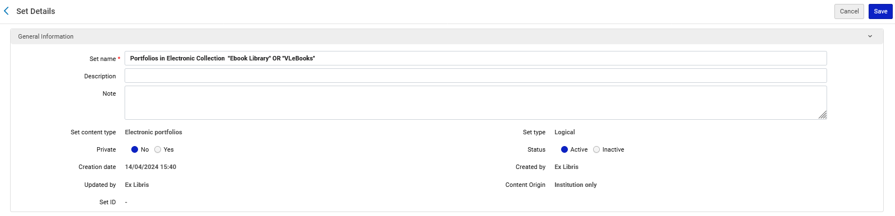
Change Electronic portfolio information
We have called the set “Portfolios in Electronic Collection "Ebook Library" OR "VLeBooks"”

Slide 46
Change Electronic portfolio information
Now we will run the job “Change Electronic portfolio information”.
First, we will access “Run a job”.

Slide 47
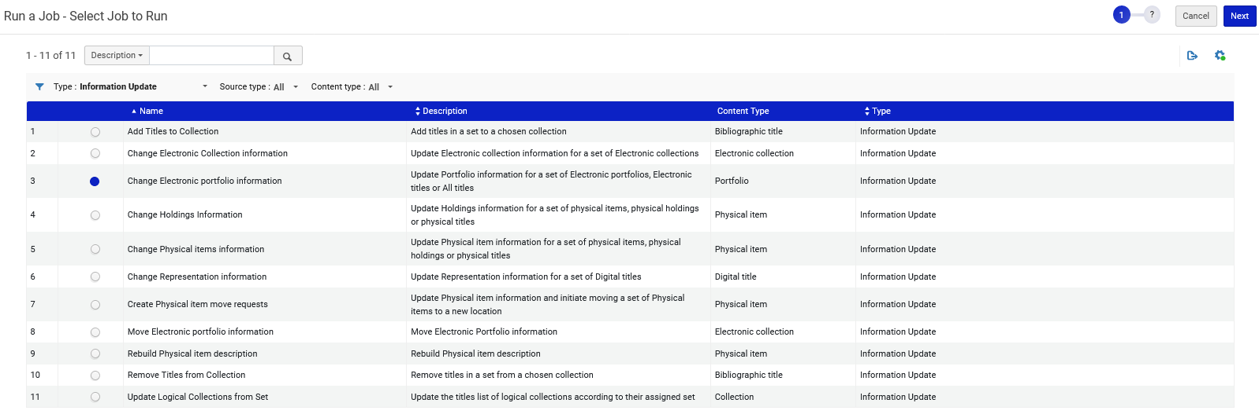
Change Electronic portfolio information
Then we will filter by type “Information Update” and choose “Change Electronic portfolio information”

Slide 48
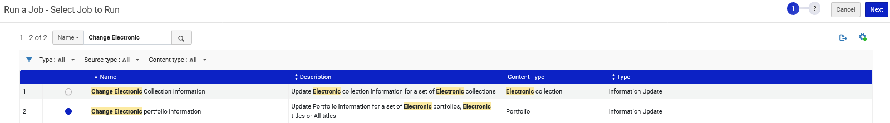
Change Electronic portfolio information
Note that it is not required to filter the “Type” of job. We can also search by name or description.

Slide 49
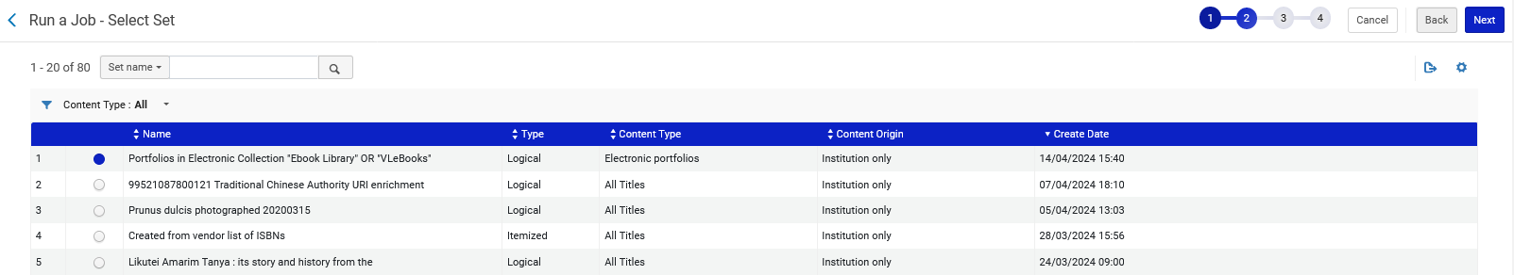
Change Electronic portfolio information
After selecting the job and clicking “Next” we will select the desired set

Slide 50
Change Electronic portfolio information
Then in the job add the authentication note “Off campus access may require additional login”

Slide 51
Change Electronic portfolio information
Confirm the change and submit

Slide 52
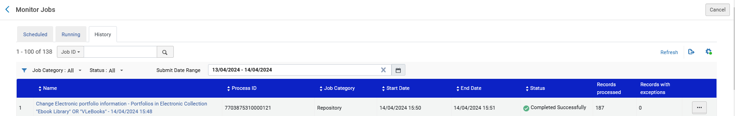
Change Electronic portfolio information
The job successfully completes

Slide 53
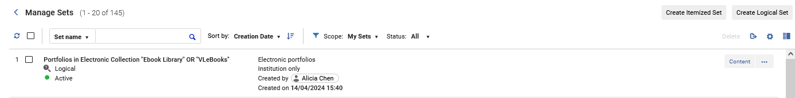
Change Electronic portfolio information
Let’s go see the portfolios in the set

Slide 54
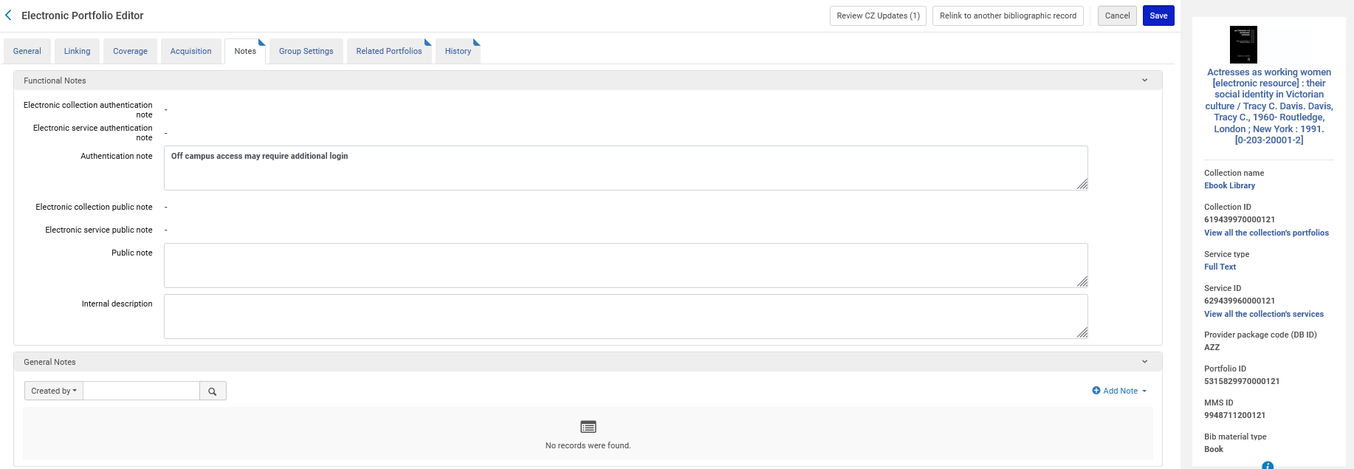
Change Electronic portfolio information
Here is title “Actresses as working women their social identity in Victorian culture”. The Authentication note has been added.

Slide 55
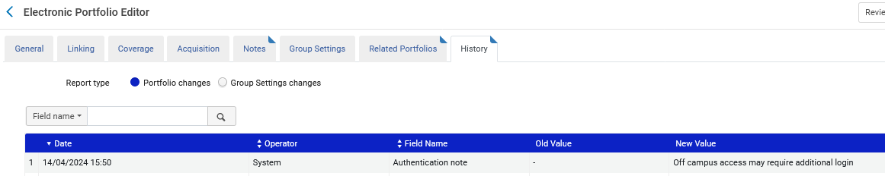
Change Electronic portfolio information
In the History tab of the Electronic Portfolio, we can see the change was made by “System” (which is a job)

Slide 56
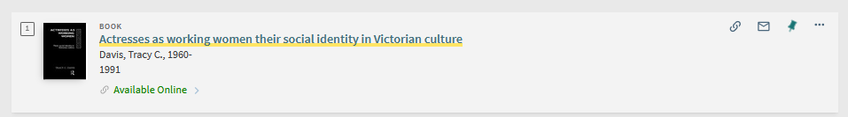
Change Electronic portfolio information
In Primo we will search for this portfolio and click “Available Online”.

Slide 57
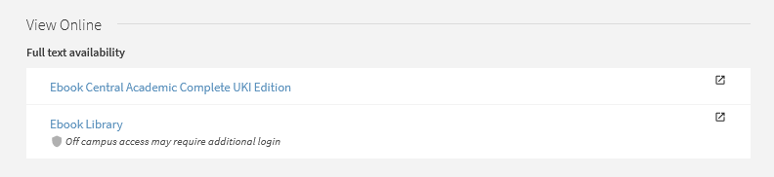
Change Electronic portfolio information
We see the authentication note for Electronic Collection “Ebook Library”

